Slide 1









GOLD SPONSORS
SILVER SPONSORS
BRONZE SPONSOR
STRATEGIC PARTNER

Slide 2
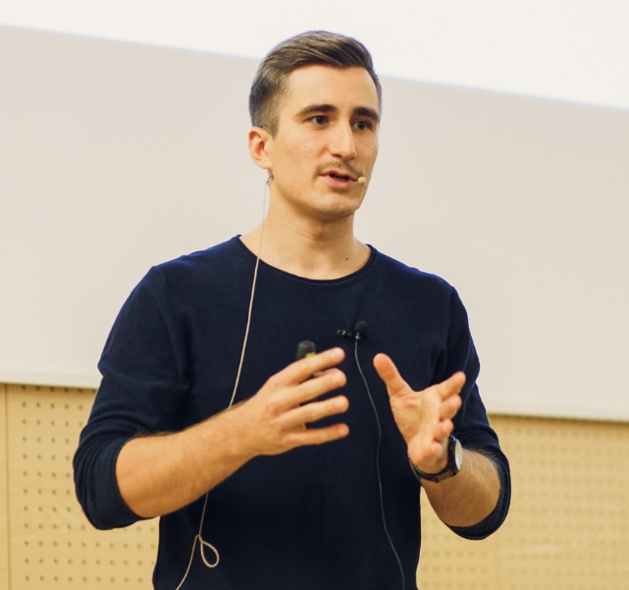



Support tickets classification using machine learning
Classifying support tickets using machine learning
Karol Żak
Software Development Engineer
CSE | Commercial Software Engineering
CEE | Central Eastern Europe
Karol Żak
Software Development Engineer
CSE | Commercial Software Engineering
CEE | Central Eastern Europe
karol.zak@microsoft.com
@KarolZak13
karolzak

Slide 3
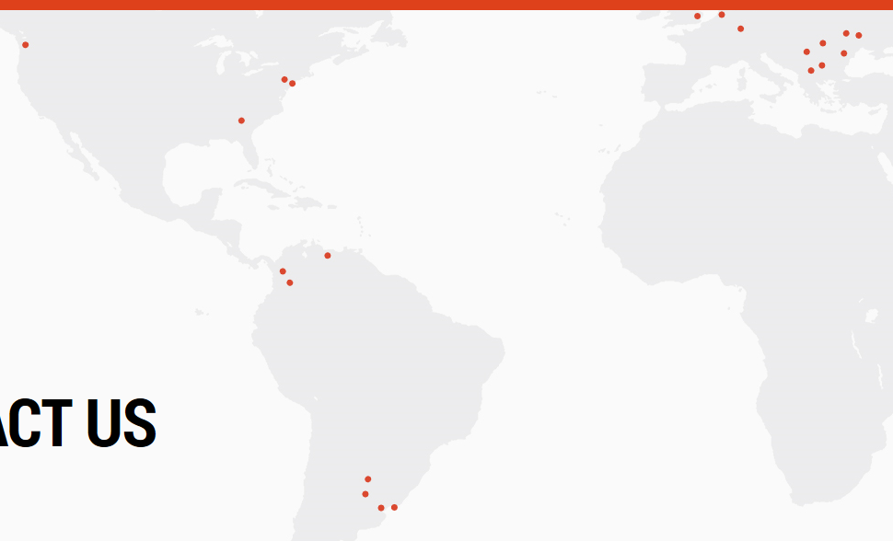

Worldwide IT service management company
Global company with 4500+ employees in offices all over the world
Endava is a privately-owned, global IT company, with over 17 years of experience of working with some of the world’s leading Finance, Insurance, Telecommunications, Media, Technology, and Retail companies. Through the Digital Evolution, Agile Transformation and Automation solutions, Endava is helping clients be more engaging, responsive and efficient.
Endava has over 4,600 employees located in offices in North America and Western Europe and delivery centres in Romania, Moldova, Bulgaria, Serbia, Macedonia, Argentina, Uruguay, Venezuela, and Colombia.

Slide 4
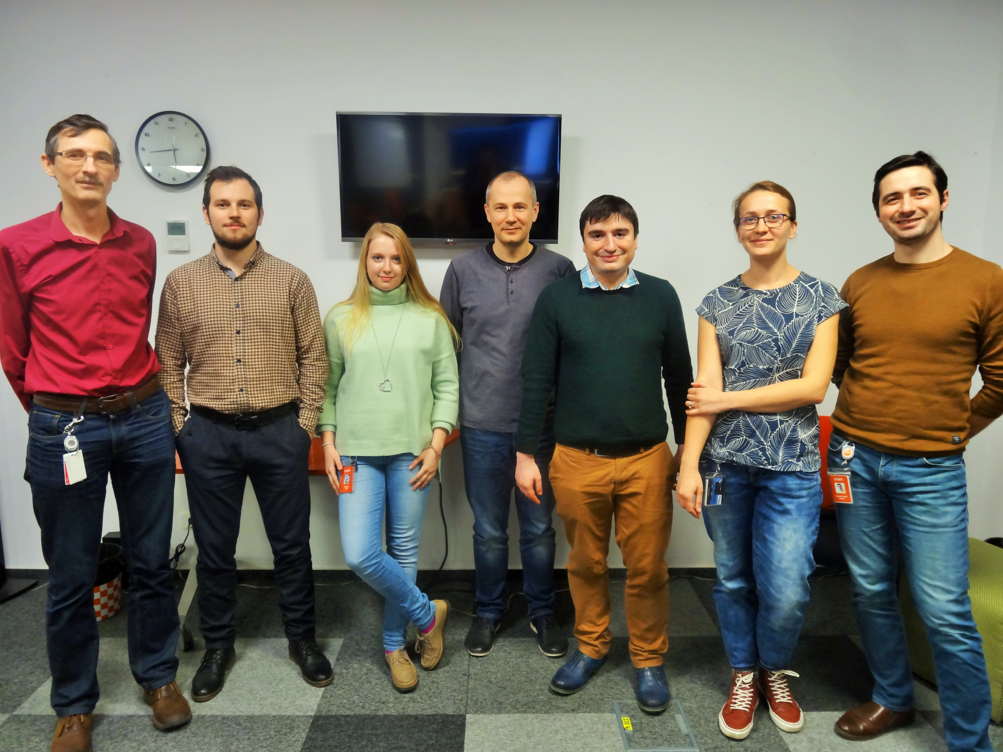
The Team
From Microsoft:
Karol Żak - Software Development Engineer
Filip Glavota - Software Development Engineer
From Endava:
Ionut Mironica - Senior Developer
Bogdan Dinu - Senior Development Consultant
Bogdan Marin - Senior Developer
Florin Vinca - Senior Developer
Ioana Raducanu - BI Analyst Developer
Andreea Tipau – Developer

Slide 5
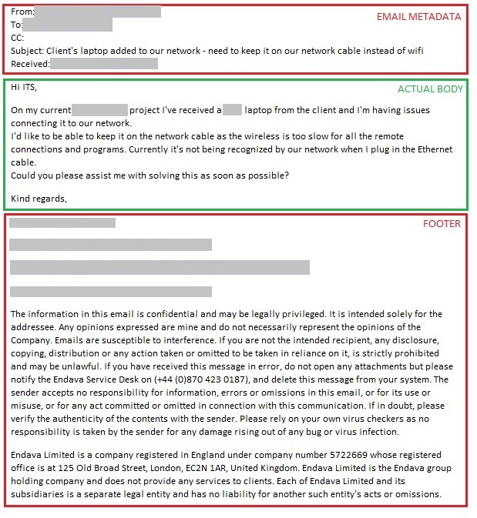
The challenge
Classify support tickets coming from email channels by analyzing text
Assign specific attributes like: ticket type (incident/request), impact, urgency, category (and sub categories), etc.
Hundreds of request per day – automatically assigning labels could massively speed up the triage process for operators
Build a POC in 3 days

Slide 6
Our approach
We split into 3 teams to try out few different approaches and compare results:
„Classic” ML in Python
Neural networks – Keras + CNTK/Tensorflow
Machine Learning Studio – classic machine learning but with visual tools

Slide 7
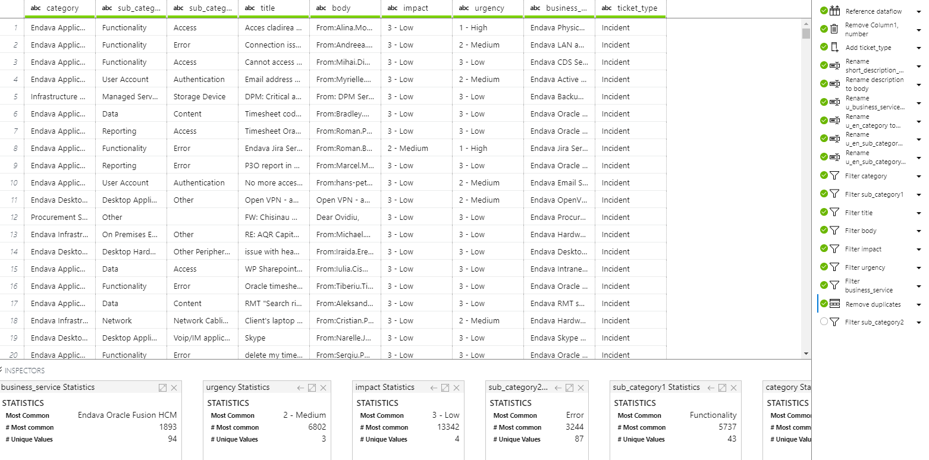
The dataset
~50k real support tickets submitted through emails
~95% of text was in English and the rest was in Romanian (for the purpose of our POC we focused on English only and removed any non-English words in preprocessing)

Slide 8
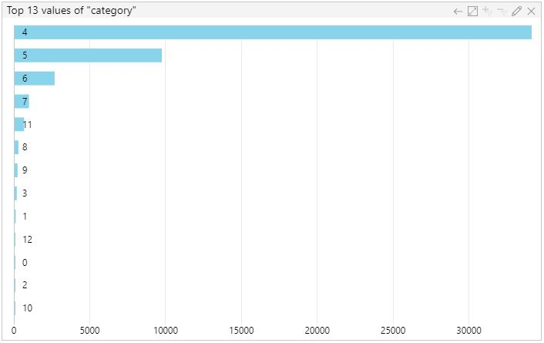
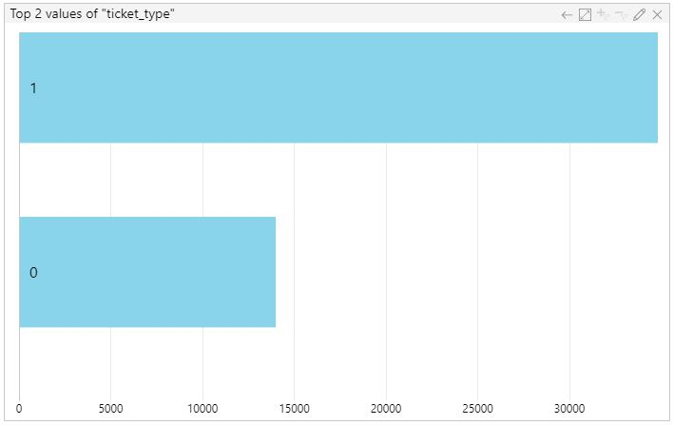
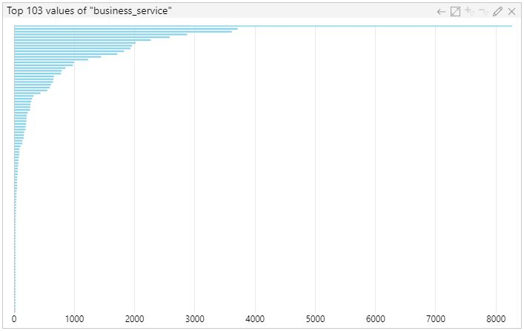
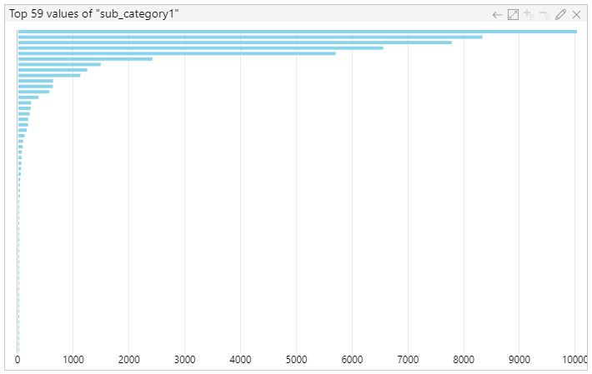
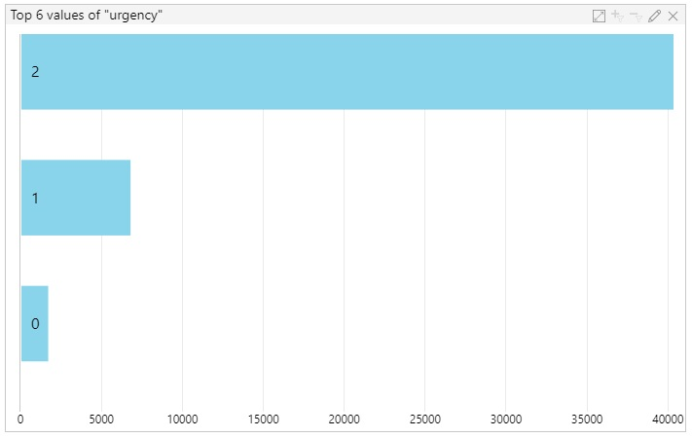
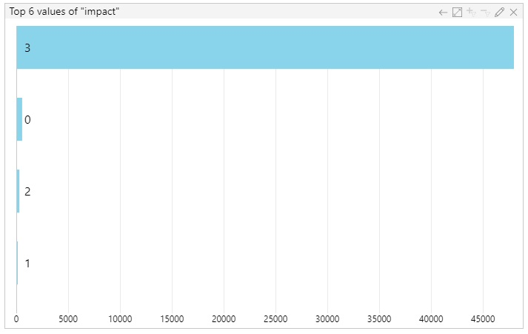
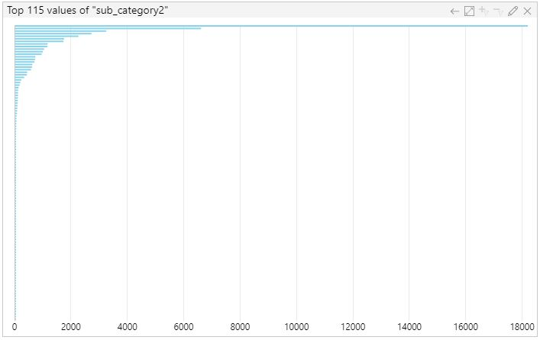
Problem of unbalanced data

Slide 9
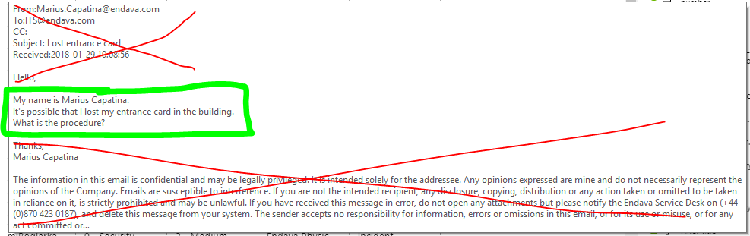
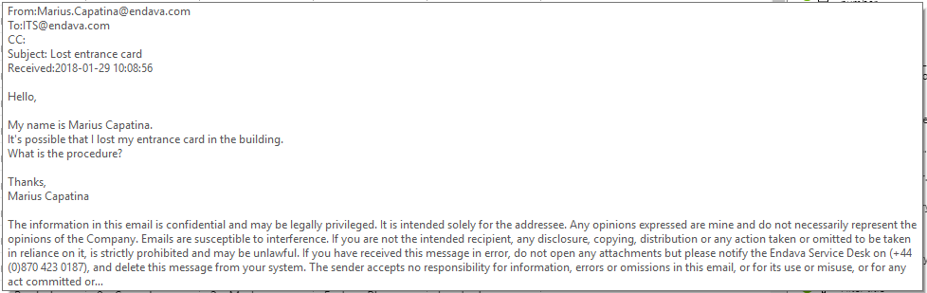
Preprocessing text data
Removed with RegEx:
Email metadata
Footers
Names
Hyperlinks
Image references
Special symbols
And more garbage
Names and Romanian words were removed using english vocabulary dataset (100k+ words) and names dataset (5,5k names)

Slide 10
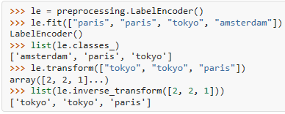
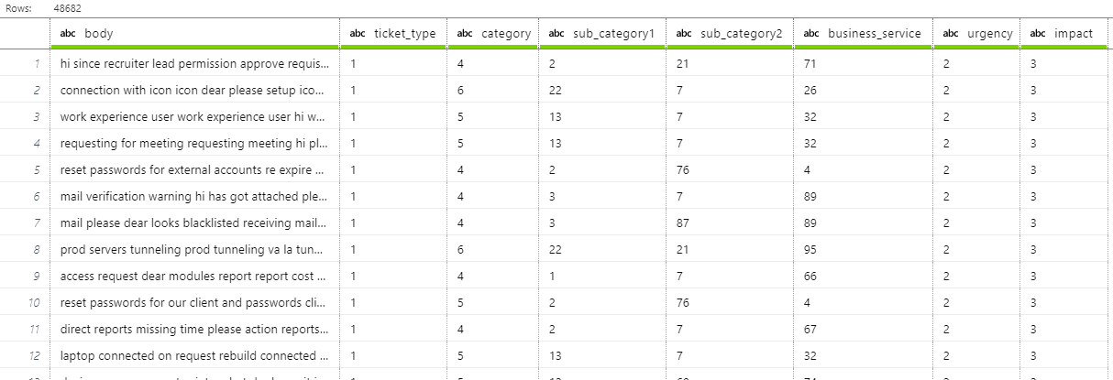
Data anonymization for publishing purposes
sklearn.preprocessing.LabelEncoder
Annonymized dataset is available publicly at GitHub repo

Slide 11
DEMO
Data preprocessing

Slide 12
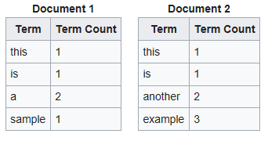
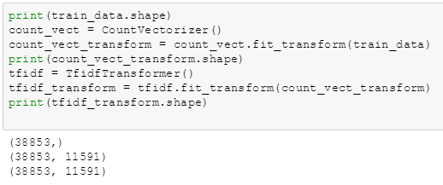
Feature extraction from text
General idea -> Bag of words
Implementation in Python -> CountVectorizer
Extracts all the unique words, presents each as a separate column and then for each text it counts the occurance of each word
Counting number of unique words for each text is not enough because some texts might be much longer then other and thus have bigger weights. That’s why we also considered Term Frequencies
TF-IDF (term-frequency times inverse document-frequency)

Slide 13
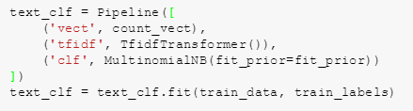
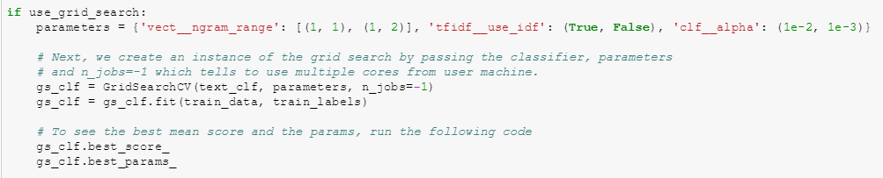
Training the model
Pipeline for easier preprocessing of data
Naive Bayes (MultinomialNB) to train the model
GridSearchCV to tune hyperparameters

Slide 14
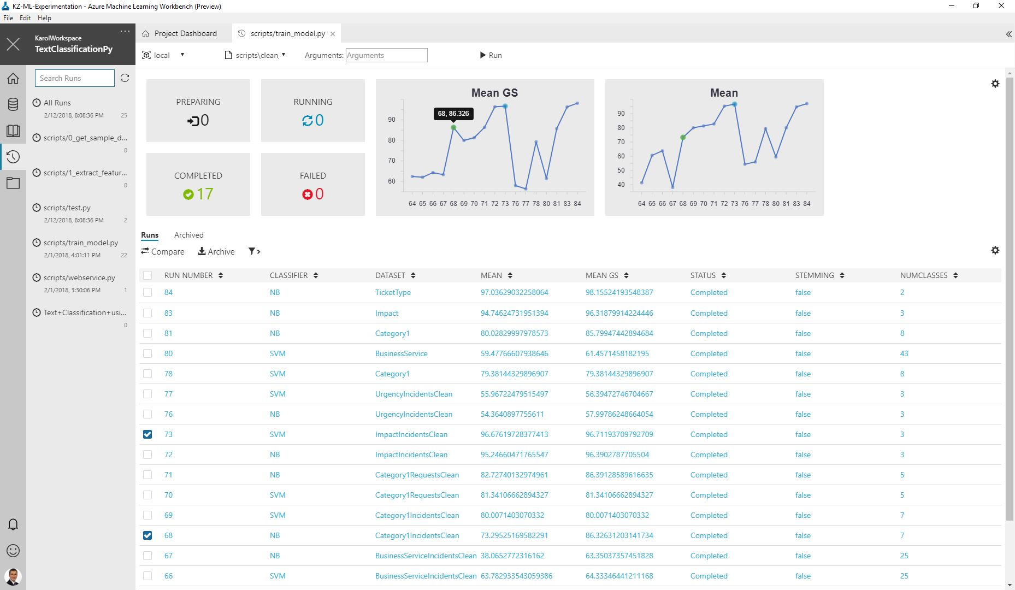

Slide 15
DEMO
Training the model

Slide 16
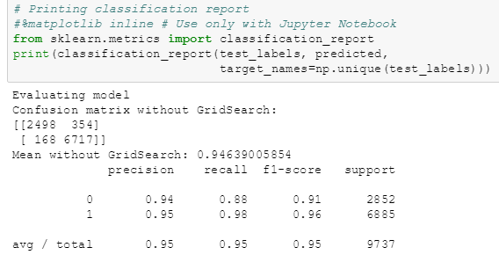
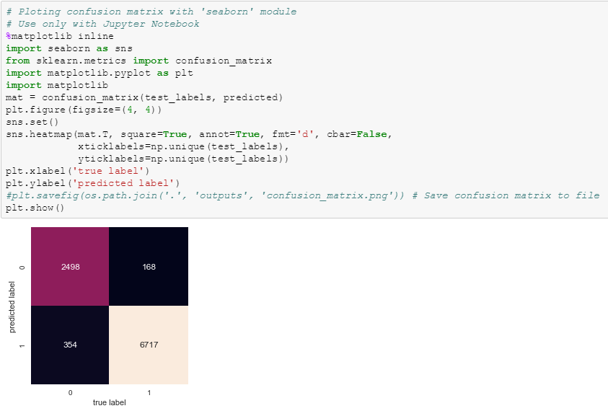
Results - visualization

Slide 17
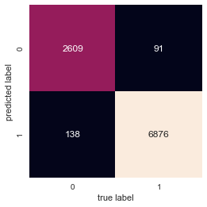
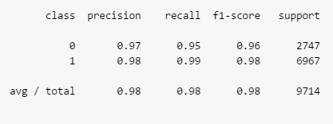
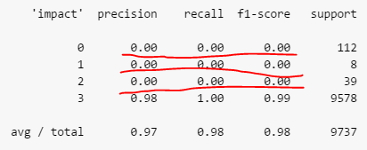
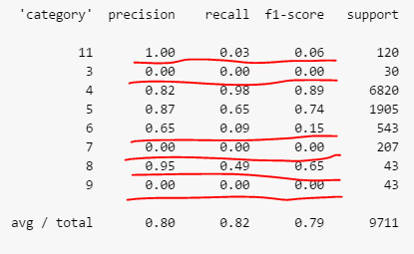
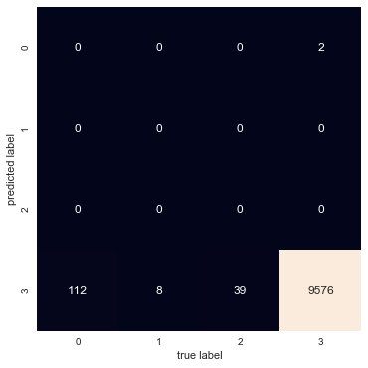
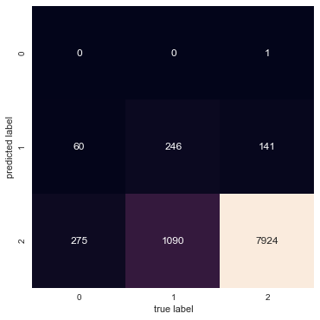
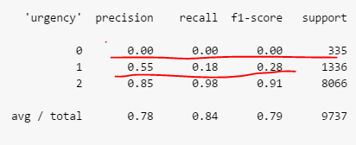
Results
Confusion matrix for „ticket_type”
Results for classifying „ticket_type” were very good
But for all other attributes results were less amazing (even though average numbers were good):

Slide 18
GitHub repo
https://github.com/karolzak/Support-Tickets-Classification

Slide 19
Related sessions @SQLDay2018
Tuesday:
Klasyfikacja obrazów przez modele uczenia maszynowego Marcin Szeliga | Room C | 14:10-15:10
Azure Machine Learning Workbench Łukasz Grala | Room B | 15:30-16:30
Wednesday:
Integracja wieloźródłowych heterogenicznych danych przy użyciu języka Python Agnieszka Cieplak & Tomasz Cieplak | Room C | 15:00-16:00
Azure Databricks: big data made easy Michał Żyliński | Room C | 11:40-12:40

Slide 20
Thank you!
Classifying support tickets using machine learning
Karol Żak
Software Development Engineer
CSE | Commercial Software Engineering
CEE | Central Eastern Europe
Karol Żak
Software Development Engineer
CSE | Commercial Software Engineering
CEE | Central Eastern Europe
karol.zak@microsoft.com
@KarolZak13
karolzak

